Slide 1
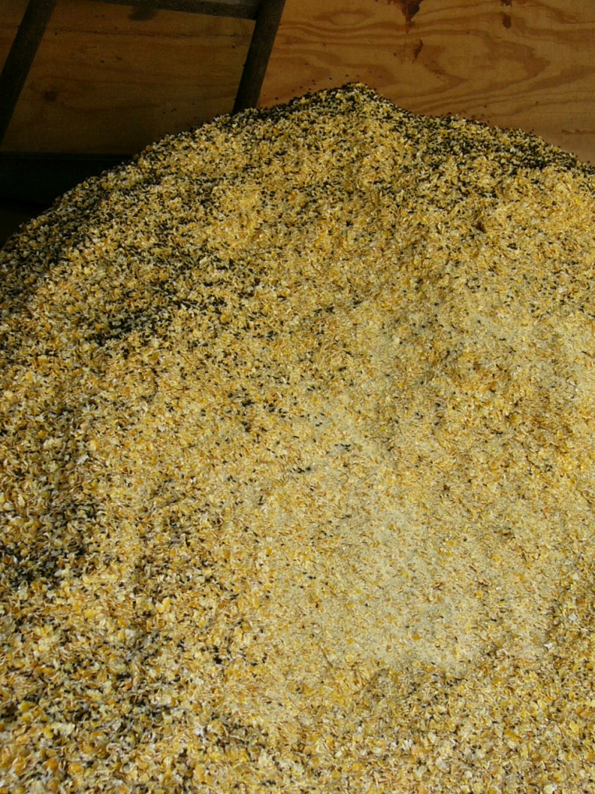
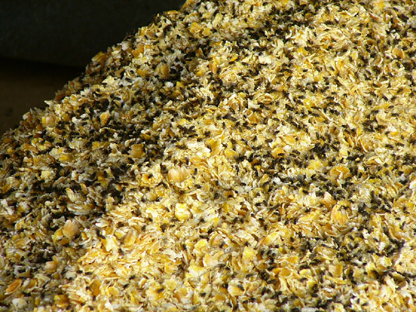
Figure 1. Fresh steam-flaked corn with a large population of house flies (dark spots) in summer months. A) low power and B) higher power image.
A
B

